Slide 1

Avoiding the Summer Slide
Toni Brooks
Supervisor, Instructional Support
Division of Academics
tbrook@pgcps.org
301-386-1577
Notes:
Thank you for the opportunity to talk summer with you today. It’s early March but the last day of school will arrive in mid-June so now is the time to make your summer plans. It’s my honor as the supervisor of Instructional Support to have the responsibility to serve as a clearinghouse for summer programs. We collect information from the summer managers and distribute it, in other words. The topic for our time together this evening is “avoiding the summer slide.” This topic is important every year. Next slide please.

Slide 2

Summer Slide Defined
Summer Learning Loss
Tendency for students to lose some gains in achievement
20%-40% learning loss depending on the study
Occurs when students are not involved with academic activities.
Math, Vocabulary, Reading are most impacted
Notes:
Let’s start with definitions. Summer slide is also known as summer learning loss or the tendency for students to lose some of their gains in achievement. Two students, Toni and Sheila, who end the school year learning at the same place, have different summer experiences with educational engagement and learning. Sheila has worked on academic learning during the summer - worked the muscle memory for the academic skills by reading from the recommended reading lists, spending time at the library, and doing math calculations; but Toni didn’t read, write, or do arithmetic. In fact, Toni wonders aloud - what was that teacher talking about last year

Slide 3

Tips to Avoid Summer Slide
Schedule learning on a calendar and see how it adds up
Engage in daily learning 30-60 minutes
Read, Write and Calculate Daily
Schedule limited screen time
Play thinking games like Yahtzee
Enroll in a summer program
Notes:
We use our calendars as a tool so that we are doing what we need to do when we need to do it. Proactively, use the calendar for the same purpose in the summer and watch your efforts add up. Schedule 30-60 minutes of daily learning and the summer slide should go away. Read a few pages from a favorite book or author every day; keep a journal of events or a gratitude journal to keep up the practice of writing. Complete mathematics calculations. Play thinking games like yahtzee or monopoly. If it doesn’t overlap travel plans, consider enrolling in a summer program.

Slide 4

Prince George’s County Opportunities
Grades 2-8 Language Arts, Math, STEAM
Prince George’s Community College
2024 Owl Scholars Schedule
limited space
Apply early
Notes:
In Prince George’s County, we have a lot of options. Students in grades 2-8 can attend Prince George’s Community College. Let’s look at the offering in the link - scroll to the Owl Scholars schedule and click there. Page 3 says limited space, register now. Pages 5-10 provide the offerings and descriptions and registration is on page 11.
PGCC even offers an extended day program. Returning to our slide presentation, Prince George’s County Government hosts an annual summer youth enrichment program - Getting Prepared Guide, 6 steps to application, job descriptions.
If you are willing to travel - check other area opportunities; compare the parks, compare the water parks

Slide 5

Prince George’s County Opportunities
Ages 14 to 24 summer work experiences
Prince George’s County Summer Youth Enrichment Program
apply March 1-31

Slide 6


Prince George’s County Opportunities
All Ages
Prince George’s Parks and Recreation - March 13 registration opens
Prince George’s County Memorial Library System (pending)

Slide 7

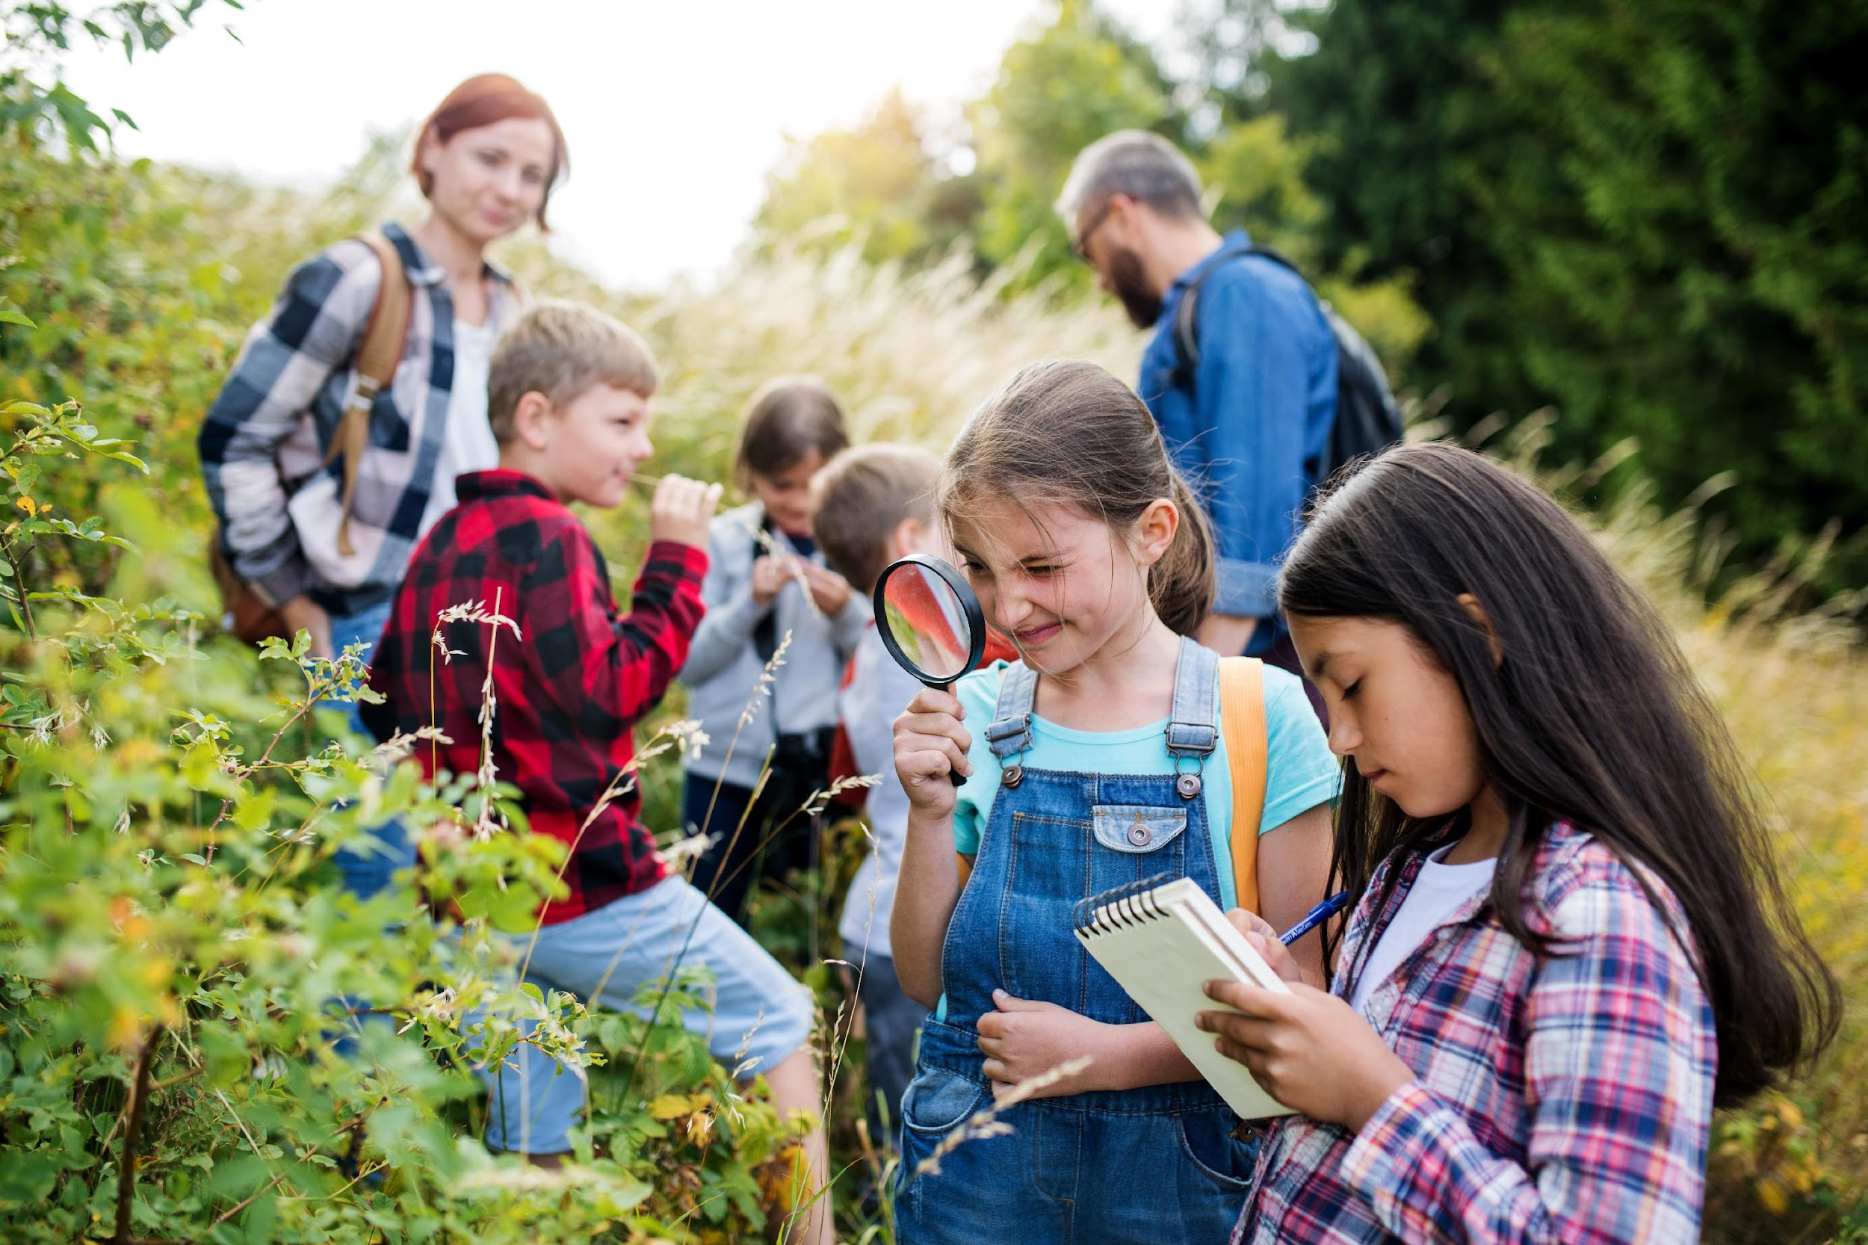

PGCPS Best Practices for Summer Learning
Academic Enrichment
Accelerated Learning
Opportunities
Support for Transition to Middle and High School
(Hanover Research, 2020)
Notes:
In Prince George’s County Public Schools, we comply with the best practices for Summer Learning aligned with one or more of the following 3 tenets: Academic Enrichment, Accelerated Learning Opportunities and Support for Transitional grades to either middle or high school

Slide 8




PGCPS Summer 2024
Summer Programs 2024 Webpage link active March 22
Students participate in enrichment, acceleration, bridge, or credit recovery.
Most programs are Face to Face; Some are Virtual
Support provided by certified content area teachers and includes Social-Emotional Learning and program goals.
Notes:
PGCPS offers enrichment, acceleration, bridge, and credit recovery programs. Most of the programs are face-to-face and a handful are virtual. When the summer guide is available on March 22, face to face or virtual will be indicated as well as whether transportation and meals will be provided. Teachers in summer programs are certified and programs include social-emotional learning and SMART goals.

Slide 9
Outcomes
Summer Learning Programs Outcomes Report Highlights:
1388 Elementary Acceleration Academy
Reading/ELA growth – 39.0%
Math Growth rate – 56.7%
1867 Middle Intervention and Enrichment
R/ELA growth rate = 28.3%
Math growth rate = 35.8%
ESOL growth rate = 60.0%
8757 High School Credit Program
78.9 to 92.4 earn credit depending on the course
Outcomes
Notes:
On the topic of goals our system-wide elementary, middle and high school programs exceeded their goals in a previous year per the report linked at the top of this page. Recall our two students - Toni and Sheila - Sheila attended an elementary summer program and experienced a growth in English of 39%. Toni didn’t attend a summer program or do any learning activities and experienced a learning loss of 20%. When they begin the school year, Toni is substantially ahead of Sheila educationally and that’s a result of only one summer. Imagine what happens summer after summer. This latest published report reveals that summer programs are highly successful with growth rates in English, Mathematics, and ESOL and a high rate of students earning credit toward graduation in high school. Look at the number of students and their growth rates or graduation credit earning rates.

Slide 10
Elementary/Middle Sneak Peak
30+ school-based programs for all grades plus:
Elementary School
County Wide
Camp Schmidt Day Program
Judy Center Pre-Kindergarten
Middle School
County Wide
Middle School Intervention
Positive Deputies Assisting Youth (D.A.Y.)
Specialty Programs
French Immersion
Title 1 Science Technology Engineering Art Math (STEAM)
Offerings
Notes:
So here is a sneak peak of what we’ll offer for summer 2024. This is pending the publication to come out on March 22. Many of our students experience Camp Schmidt during the school year and this summer students in grades 4-6 are invited to participate in the Schmidt experience. Our pre-Kindergarten program is welcoming all entering Pre-K students. In middle school, we will offer an intervention program for students who need additional academic support and the Positive DAY program tht many of our middle schoolers experience during the school year is offering a summer session. Middle school specialty programs for French Immersion and the Title 1 STEAM program will be available for program students.

Slide 11
High School Sneak Peak
County Wide
College Readiness Bootcamp
Credit Recovery and Original Credit
Healthcare Careers
Teen Adventure Camp
Specialty Programs
Aerospace
Cadet Officer Leadership Program
International Baccalaureate
International High School
Pathways in Technology Early College (PTECH)
Science and Technology
Talent Ready
Offerings

Slide 12
Summer Programs 2024
Toni Brooks
Supervisor, Instructional Support
Division of Academics
tbrook@pgcps.org
301-386-1577
Notes:
We appreciate the time that was allotted today for the topic of summer programs. Please email me and cc the Family Institute designee if you have any follow up questions.

