Slide 1
Family Institute Session:
Be THAT Powerful and Engaged Parent
Facilitated by:
Dr. Sheila Jackson, Director
Department of Family and Community Partnerships
Notes:
Thank You!!! - Heath

Slide 2


SERVICIOS DE INTERPRETACIÓN INTERPRETING SERVICES
Tonight’s Simultaneous Interpreter: / Intérprete simultánea de esta noche: Iliana Stivason - iliana.stivason@pgcps.org
On a computer-- At the bottom of the screen will be an interpretation globe. Click that globe and then select Spanish.
En una computadora-- En la parte baja de la pantalla habrá un globo de interpretación. Haga clic en ese globo y seleccione "Spanish."
On a mobile device-- At the bottom of the screen, tap the ellipses icon on the bottom right (...).
Tap Language Interpretation.
Tap Spanish.
En un dispositivo móvil-- En la parte baja de la pantalla, toca el icono de elipses en la parte baja derecha (...).
Toque Language Interpretation.
Toque Spanish
Simultaneous interpretation is available in Spanish.
La interpretación simultánea está disponible en español.

Slide 3

Who is Here This Evening?
Please complete our Secure Attendance Roster Process: https://forms.gle/fp5UEe3w5cwF9AFB7
    If you cannot access the form, please use the chatbox and tell us: Date of this session; your name; school affiliation; and role

Slide 4

SESSION NORMS
Please:
Sign in on our Secure Attendance Form: https://forms.gle/fp5UEe3w5cwF9AFB7
Cameras on and microphones off.
Participate freely.
Assume positive intentions.
Speak and listen with respect.
Share succinctly.

Slide 5
AGENDA
HAPPY NATIONAL FAMILY ENGAGEMENT MONTH!!
6:00 - 6:15 Welcome, Introductions & Check-In
6:15 - 7:15 Presentation: Be THAT Powerful and Engaged Parent!
7:15 - 7:25 Open Discussion, Q&A, Opportunities for Feedback
7:25 - 7:30 Meeting Evaluation and Closure

Slide 6
Who am I?
PGCPS Director for the Department of Family and Community Partnerships
Exceptionally blessed spouse and mother of four PGCPS graduates and Grandma Gi-Gi of a precious four-year old Granddaughter, Farah, her 20 month old sister, Serena, and their 6 month old cousin, Marley!!
THAT Parent =
  “very engaged” form 1987 until the last graduate in 2006 & who some school system folks wished would “go away” and “get a job” because I was at the school so much volunteering and offering input…
    SURPRISE - the school system hired me over 30 years ago to help deepen and broaden family engagement in PGCPS!!

Slide 7
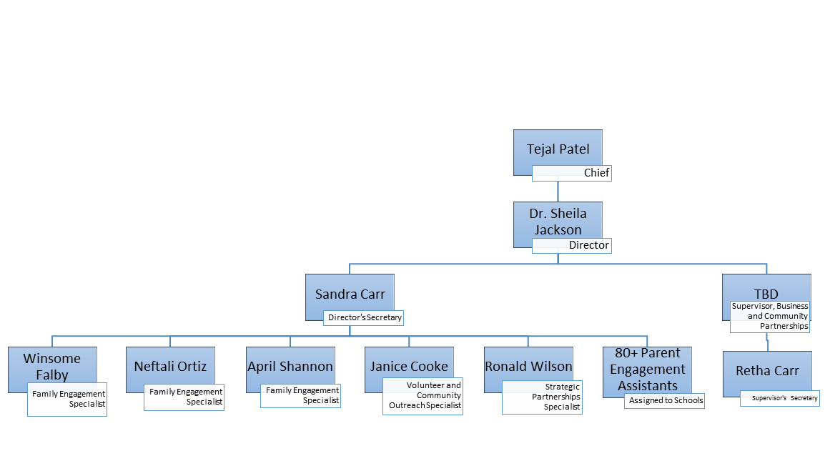

Meet the DFCP Team
Who are we?
PGCPS Division of Communications
and Community Engagement’s
Department of
Family and Community
Partnerships

Slide 8

WHY This Family Institute Session?
…It’s About Building “Dual Capacity” to Ensure Successful Outcomes for
ALL of Our Children

Slide 9
OUTCOMES
Participants in this meeting will learn, share and model:
  Tips for increasing our own self-efficacy in being recognized, acknowledged and embraced as THAT POWERFUL and ENGAGED Parent who works to secure successful student outcomes and to create and achieve their vision of effective family partnerships between school and home!

Slide 10
Getting Started...
Please express ONE WORD that explains how you feel RIGHT NOW about your experience as a parent/guardian/family leader in partnership with PGCPS , on the Whiteboard for one minute!

Slide 11

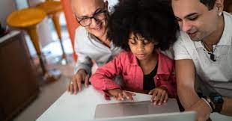
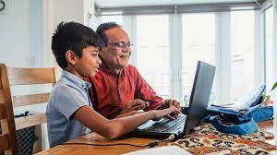


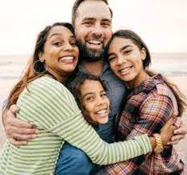

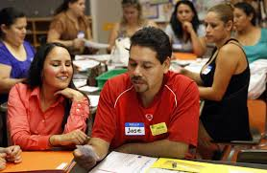
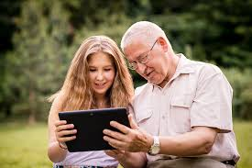
Tonight’s Presentation
“Be THAT Powerful and Engaged Parent!”

Slide 12

What IS Family Engagement?
“Family engagement is a full, equal, and equitable partnership among families, educators and community partners to promote children’s learning and development from birth through college and career.” - Dr. Karen Mapp from Harvard Graduate School of Education
“Family engagement is best thought of as a collection of habits. It’s all about the things that parents/families and educators do each and every day that build a meaningful relationship between home and schools.” - Rebecca Honig from ParentPowered and Jessica Webster from the Mid-Atlantic Equity Consortium

Slide 13

Remember:
Family engagement comes in so many different flavors, each reflective of the unique qualities and makeup of diverse communities’ “funds of knowledge,” unique skills and strengths, and cultural backgrounds.
But what matters most is this: students gain the greatest support when there are trusting, reciprocal relationships among these critical adults around them. And this is what is remarkable about taking time to “unlock our potential” as parents/families to boost student learning while we build partnerships between home and school!

Slide 14
The COLLECTION of HABITS
Being THAT engaged and powerful parent “looks like,” “sounds like,” and “feels like” possessing and walking in these eight HABITS:
Partner/Collaborator
Supporter
Encourager
Decision Maker
Learner
Monitor
Model
Avocate/Activist
Notes:
Partners in the teaching and the child/adolescent growth and development process in support of their children’s learning and development
Decision Makers on school and community teams focused on choosing educational options for their children, the school, and community
Supporters in the broader community for improved learning opportunities for their children and at their schools
Learners of effective strategies to continuously build parent, family and community efficacy for supporting the success of all children
Encouragers of an “achievement identity,” a positive self-image, and a “can do” spirit in their children
Monitors of their children’s time, behavior, boundaries and resources
Models of lifelong learning and enthusiasm for education
Advocates/Activists and Collaborators with school staff and members of the community on issues of school improvement and reform

Slide 15

THAT parent demonstrates:
…the HABIT of:
Partner/Collaborator
Parents are our children’s first, most long-lasting and influential teachers and possess enormous Funds of Knowledge that they bring to the table as parenters and collaborators
Notes:
Parents are our children’s first teachers and possess enormous Funds of Knowledge that they bring to the table as parenters and collaborators

Slide 16
As a Partner/Collaborator
The most important thing to do
between home and school
is to focus on developing and maintaining a positive and productive relationship with your child’s teacher and the school’s administrative team!

Slide 17
RELATIONSHIPS
“Nothing is more important to the success of children than the quality of between and among students, educators and parents.”
-Dr. James P. Comer, 1970
relationships

Slide 18
As a Partner/Collaborator
Learn and know how to communicate effectively in order to raise, address and resolve concerns in a mutually beneficial way.
Three main ways exist:
Attend and/or ask for a Parent/Teacher Conference
Steps for raising concerns between home and school
A Guide to Addressing Questions and Concerns

Slide 19
First 2 Steps for Partnership:
Attend and/or ask for a Parent-Teacher conference
Report any student focused concern to the staff where the concern originated: (Teacher, then Professional School Counselor, then Assistant Principal, then Principal)
  If unresolved at the school, contact the next level staff supervisor: (Instructional Director, then Associate Superintendent)
  If still unresolved, submit a letter of concern or call to the Office of the Chief of School Support and School Leadership via web: https://www.pgcps.org/offices/superintendent/executive-cabinet/dr.-rahshene-davis or call 301-952-6575

Slide 20
A Guide for System Level Concerns
A Guide to Addressing Questions and Concerns

Slide 21
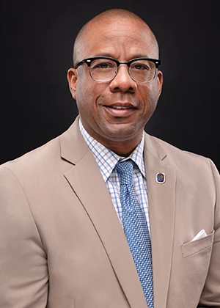
#4 Reach out to
District Leadership
Millard House II was appointed Superintendent of Prince George’s County Public Schools (PGCPS), effective July 1, by Prince George’s County Executive Angela Alsobrooks.
He plans to continue to accomplish the goals of the Transformation 2026 Strategic Plan with strategic nuances to help us acclerate our forward movement. The systemic focus will remain and be enhanced for Mathematics, Culture and Climate, and Social and Emotional Learning.
Please read more about him and his executive team here:
https://www.pgcps.org/offices/superintendent
His message: “It is both an honor and a pleasure to join Prince George’s County Public Schools. I look forward to listening and learning in the days ahead in an effort to build upon a rich tradition of educating students in an equitable manner.”
Superintendent House

Slide 22
# 5 Last Resort:
PRINCE GEORGE’S COUNTY
BOARD OF EDUCATION
Judith Mickens-Murray, Chair
Lolita E. Walker, Vice Chair, District 9
David Murray, District 1
Jonathan Briggs, District 2
Pamela Boozer-Strother, District 3
Shayla Adams-Stafford, District 4
Zipporah Miller, Ed.D., District 5
Branndon D. Jackson, District 6
Kenneth F. Harris II, Ph.D., District 7
Madeline LaSalle Frazier, LCSW, Ed.S., District 8
Walter E. Fields, Appointed, At Large Member
Juanita D. Miller, Ed.D., Appointed, At Large Member
Jocelyn Route, Appointed At Large Member
Rayne Rivera-Forbes, Student Board Member
Millard House II, Secretary/Treasurer and Superintendent

Slide 23

THAT parent demonstrates:
…the HABIT of:
Supporter
The most important supporter in a child’s life is his/her parent, guardian, or care taker. Whatever
or whomever a child dreams to become, they achieve it best with that support, nurturance, belief, and unconditional love!

Slide 24


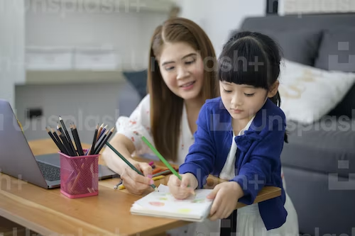
THAT parent demonstrates:
…the HABIT of:
Encourager
Parents have the power to model and instill an “achievement identity,” a positive self-image, and a “can do” spirit in children!

Slide 25

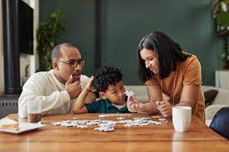
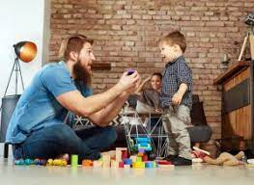
THAT parent demonstrates:
…the HABIT of:
Decision Maker
Parents model and teach their children the skill of making decisions for themselves and for the good of others! They serve in PTA/PTO and on school teams and committees as well as partners in shared decision-making as well!

Slide 26

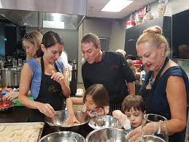


THAT parent demonstrates:
…the HABIT of:
Learner
Parents who are learners themselves = always seeking knowledge and growth, reflect their positive changes in the eyes of their children and the world!

Slide 27



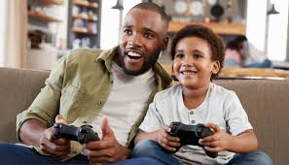
THAT parent demonstrates:
…the HABIT of:
Monitor
Powerful parents monitor and assist where needed to help establish boundaries with their children and colleagues!

Slide 28


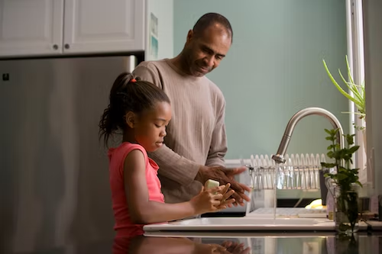

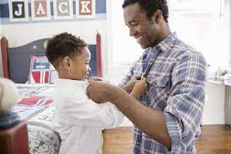
THAT parent demonstrates:
…the HABIT of:
Model

Slide 29
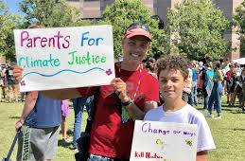
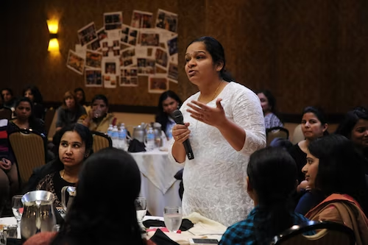
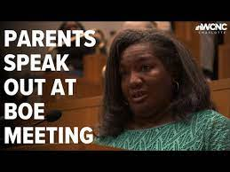

THAT parent demonstrates:
…the HABIT of:
Advocate/Activist
Parental voice and action with and for children has far reaching impact

Slide 30

QUESTIONS?
Dr. Sheila Jackson, Director
Department of Family & School Partnerships
Family Institute
301-618-7356
pgcps.family@pgcps.org

Slide 31
SESSION CLOSURE
Thank you for your participation in our session. As a data-driven office, your input and feedback are invaluable for helping us improve our services! Please complete this session feedback and evaluation form: https://forms.gle/fQrkjsUUGQQmBGqFA
Please enjoy the rest of your evening while reflecting upon what we all must continuously do in the best interests of all children!!

Slide 32

Hope to See You Next Time!!
Next sessions:
11/8: Code of Conduct for Families, Volunteers and Visitors
11/16 Honor & Celebrate Diversity
12/7 Keeping Our Children Safe
12/14 Overview of Special Education
Contact information:
Dr. Sheila Jackson: sjackson@pgcps.org
Department of Family and Community Partnerships
Family Institute
301-618-7356

Slide 33


In Conclusion...

